Slide 1



M3W7 – Security and real world HTTP servers

Slide 2
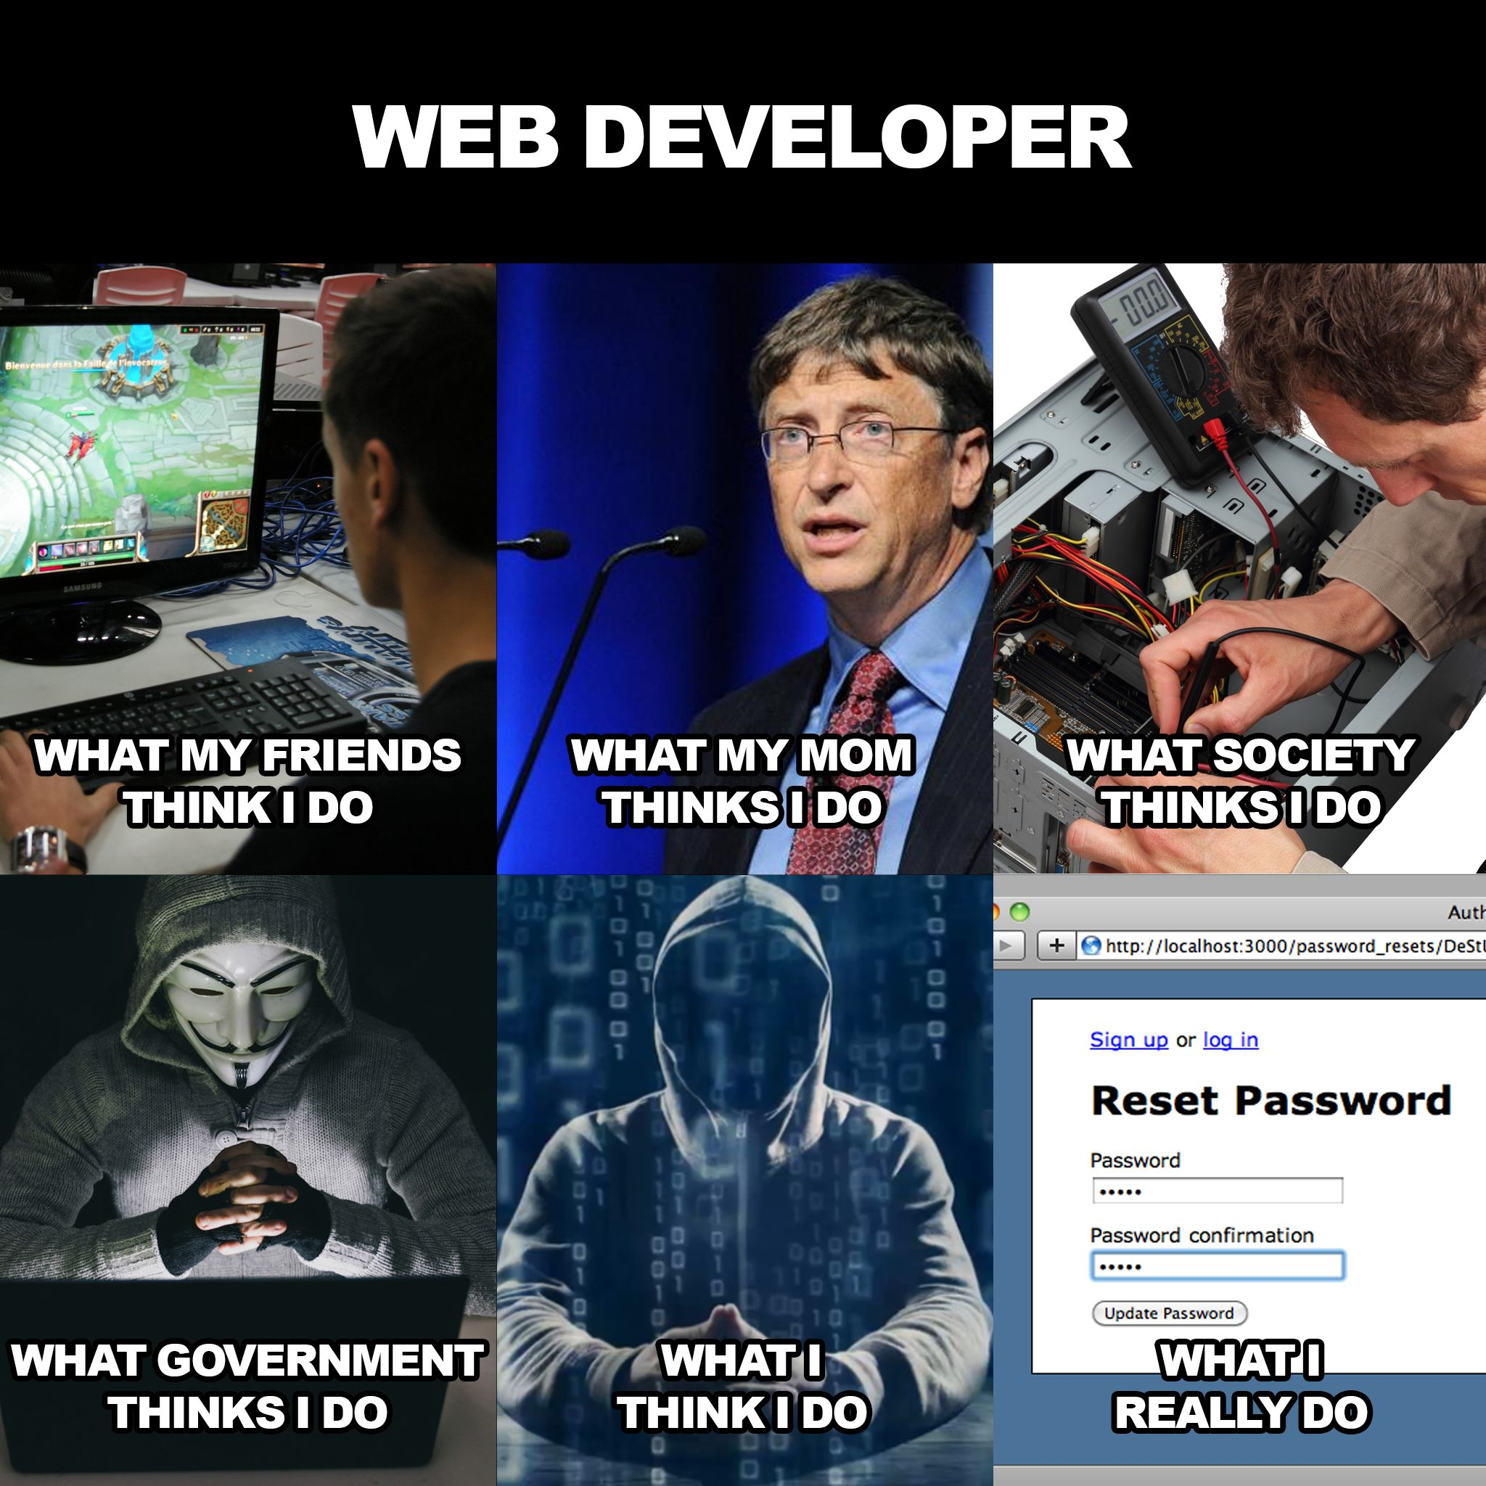

Slide 3

Agenda
REVIEW REQUIREMENTS
SECURITY
REST
MIDDDLE WARE

Slide 4

REVIEW REQUIREMENTS
Tiny App?
Notes:
What are callbacks? Anyone remember what these are?

Slide 5
CRUD
Make sure to review the full list of requirements before submitting your TinyApp project
Basic Permission Features:
https://web.compass.lighthouselabs.ca/days/w03d3/activities/489
More Permission Features:
https://web.compass.lighthouselabs.ca/activities/1156
Full List of Requirements:
https://web.compass.lighthouselabs.ca/projects/tiny-app

Slide 6
SECURITY
TAYLOR, WHAT DO YOU HAVE TO SAY?

Slide 7

I dropped my code, it's so hazy, My website needs a shield, maybe? I looked to Swift, the expert lady, To learn about hashing, trust, and maybe... Encrypt my data, make it strong, Protect my users all day long. With Taylor's wisdom, I'll embrace, The tools that'll keep my site safe in the race. Hey, I just coded this, and it's crazy, But here's my site, so secure, maybe? It's hard to look right at you, baby, But with encryption, you won't breach, maybe?
Notes:
I dropped my code, it's so hazy, My website needs a shield, maybe? I looked to Swift, the expert lady, To learn about hashing, trust, and maybe...
Encrypt my data, make it strong, Protect my users all day long. With Taylor's wisdom, I'll embrace, The tools that'll keep my site safe in the race.
Hey, I just coded this, and it's crazy, But here's my site, so secure, maybe? It's hard to look right at you, baby, But with encryption, you won't breach, maybe?
My login page was weak and shaky, I needed safeguards, not just maybe. Swift's advice, I won't betray, Implementing SSL, the hacker's dismay.
Encrypt my data, make it strong, Protect my users all day long. With Taylor's wisdom, I'll embrace, The tools that'll keep my site safe in the race.
Hey, I just coded this, and it's crazy, But here's my site, so secure, maybe? It's hard to look right at you, baby, But with encryption, you won't breach, maybe?
(Bridge) Before you came into my site, I ignored the risks, it wasn't right. I wasn't looking for a code so tight, But now I see, I need security's light.
(Chorus) Hey, I just coded this, and it's crazy, But here's my site, so secure, maybe? It's hard to look right at you, baby, But with encryption, you won't breach, maybe?
(Outro) I took Taylor's lead, no more "maybes," My website's locked, no ifs or maybes. With hashing, encryption, and defenses high, My users' data will never say goodbye.

Slide 8
CRUD
Authentication vs Authorization
Authentication: Authentication is the process of verifying the identity of a user, device, or system component to ensure they are who they claim to be.
Authorization: Authorization is the process of granting or denying access to specific resources or actions based on the authenticated identity and the permissions associated with it.
Notes:
Authentication: Imagine a school dance where the bouncer checks your student ID card to confirm that you are a valid student before letting you inside the party.
Authorization: It's like getting a different colored wristband at the dance based on your age group – the school staff gives you access to certain areas or activities depending on which wristband you received after authenticating as a student.

Slide 9
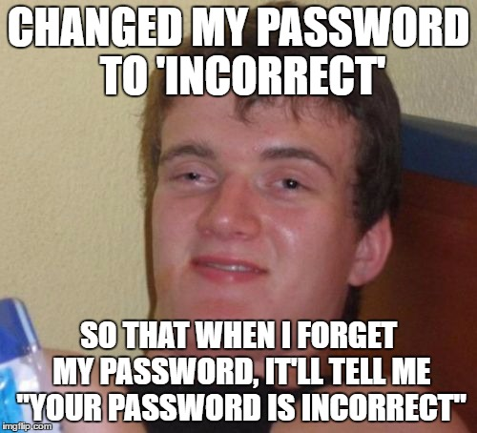
CRUD

Slide 10
SECURITY
Security issue #1: passwords
Passwords that are stored in plain text represent a security breach.
What’s the solution?
Hashing

Slide 11
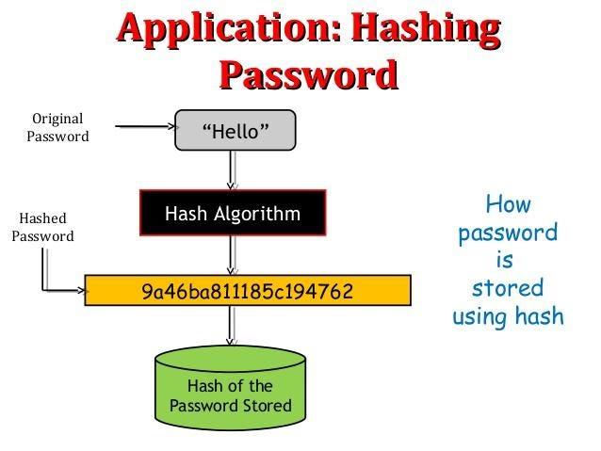
HASHING
Hashing is a one way process
Each iteration is doubling the time it takes to hash the content
We simply need to increase the iteration count if computers become more powerful

Slide 12
SECURITY
Security issue #2: Cookies
Cookie information is stored in plain-text
Plain text cookies can be modified
We might impersonate another user
What’s the solution?
ENCRYPTION

Slide 13
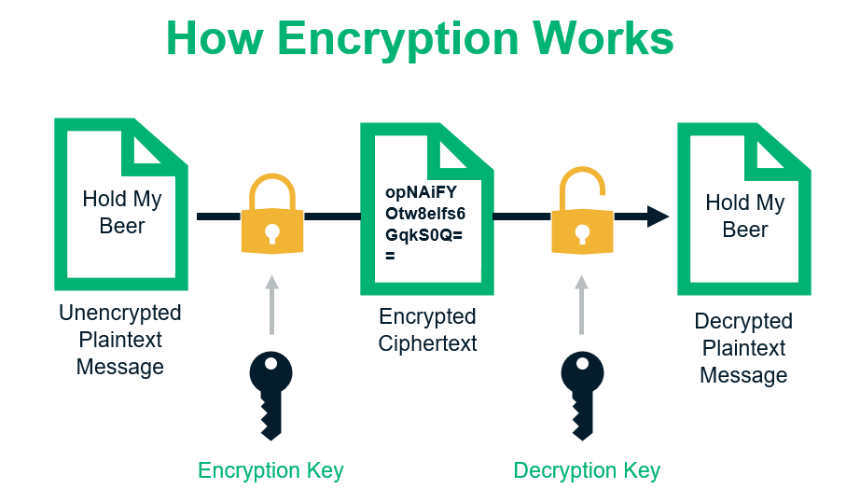
ENCRYPTION
Encryption is a two-way process
Two types of encryption: - Symmetric
- Asymmetric
What types of encryption have you seen?
Notes:
Encryption is a process that converts readable data into a scrambled form, making it unreadable without the correct decryption key.
It helps protect sensitive information from unauthorized access, ensuring confidentiality and data privacy.
Proper encryption ensures that even if data is intercepted or stolen, it remains secure and unusable without the encryption key.
Symmetric Encryption: In symmetric encryption, the same secret key is used for both encryption and decryption. The sender and the recipient must share this key in advance and keep it secret to maintain security. While symmetric encryption is efficient and faster for bulk data, the challenge lies in securely distributing and managing the shared secret key.
Asymmetric Encryption (Public-Key Encryption): Asymmetric encryption uses a pair of mathematically related keys: a public key and a private key. The public key is used for encryption, while the private key is used for decryption. Information encrypted with the public key can only be decrypted with the corresponding private key, which is kept secret. Public keys are generally shared openly, allowing anyone to encrypt data that only the owner of the private key can decrypt. Asymmetric encryption is useful for secure key exchange, digital signatures, and secure communication over insecure channels.

Slide 14
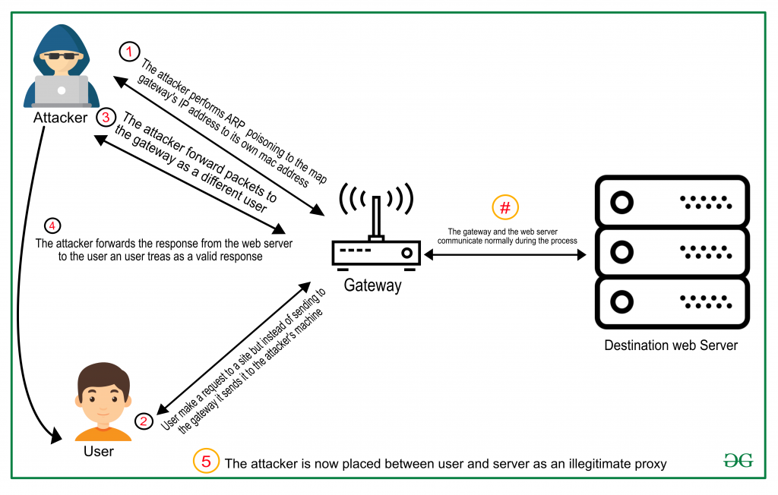
SECURITY
Security issue #3: stealing cookies
HTTP is plain-text
Man-in-the-middle attack
What’s the solution?
HTTPS
Notes:
Man-in-the-Middle (MITM) attack is a type of cybersecurity attack where an attacker intercepts and possibly alters the communication between two parties who believe they are directly communicating with each other. In the context of website cookies, a MITM attack can be used to steal or manipulate sensitive information transmitted via cookies.
Here's how a MITM attack involving website cookies might occur:
User connects to a website: Let's say a user wants to access a secure website, and they send a request to the website's server using their web browser.
Attacker intercepts the communication: The attacker positions themselves between the user and the website's server, intercepting the data transmitted between them. This can be done through various means, such as compromising the user's Wi-Fi network, exploiting vulnerabilities in network infrastructure, or using malicious software.
Website sends cookies: During the initial communication, the website's server sends cookies to the user's browser. Cookies are small pieces of data that websites use to store information on the user's device, often for authentication and session management purposes.
Attacker captures cookies: As the attacker intercepts the communication, they can capture the cookies transmitted by the website's server to the user's browser.
Manipulation or unauthorized access: With access to the user's cookies, the attacker can manipulate the contents of these cookies or use them to gain unauthorized access to the user's account on the website. For example, if the cookies contain authentication credentials, the attacker could use them to impersonate the user and gain access to their account.
Mitigating MITM attacks involving website cookies requires implementing strong security measures, such as:
Using HTTPS: Websites should use HTTPS, which encrypts the data transmitted between the user's browser and the server, making it much more difficult for attackers to intercept and read the data.
Secure cookie settings: Employing secure cookie settings, such as the Secure and HttpOnly flags, can help protect cookies from being accessed by malicious scripts and transmitted over unencrypted connections.
Regular security updates: Keeping web servers, applications, and network infrastructure up-to-date with the latest security patches can prevent known vulnerabilities from being exploited.
Using Virtual Private Networks (VPNs): When accessing websites from public Wi-Fi networks, using a VPN can add an extra layer of encryption and protection against potential MITM attacks.

Slide 15
REST
Really exquisite security Technology?
Notes:
What are callbacks? Anyone remember what these are?

Slide 16
REPRESENTATIONAL STATE TRANSFER
REST is a pattern, a convention to organize our url structure\
Resource based routes convention (The key abstraction of information in REST is a resource
It should use http verbs to express what the request wants to accomplish
Resource information must be part of the url
Notes:
REST stands for "Representational State Transfer." It's a set of guidelines and principles used to design web applications and APIs (Application Programming Interfaces). REST is based on the idea that everything on the internet, like web pages or data, can be represented as resources.
Imagine the internet as a big library, and each web page, image, or piece of data is like a book in that library. REST provides a way for different computers and servers to interact with these resources in a standardized and organized manner.
In REST, we use simple and common HTTP methods like GET, POST, PUT, and DELETE to perform different actions on these resources.
1. GET: When you want to read or retrieve data, like reading a page from a book, you use the GET method.
2. POST: When you want to create something new, like writing a new page or adding a new book to the library, you use the POST method.
3. PUT: When you want to update or change something, like editing a page in a book, you use the PUT method.
4. DELETE: When you want to remove something, like tearing out a page or removing a book from the library, you use the DELETE method.
Each resource in REST is identified by a unique URL, just like the location of a book in the library is identified by its shelf number. So, when you use a web browser or an app, you are sending these HTTP requests to interact with the resources, and the server responds with the appropriate information or actions.
REST is widely used because it makes communication between computers and servers very organized and easy to understand. It's like having a universal language for computers to talk to each other and share information, making the internet and all its services work smoothly!

Slide 17
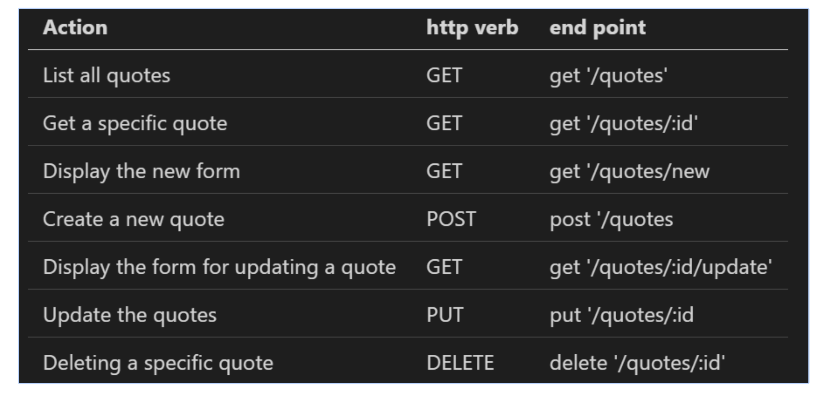
REPRESENTATIONAL STATE TRANSFER
By following REST principles, it allows us to design our end points:

Slide 18

RESTE
Nested Resources

Slide 19
Middleware
Not that complicated
Notes:
middleware refers to a series of functions or code snippets that are executed in the middle of processing an incoming HTTP request and generating an HTTP response. Middleware functions play a crucial role in Express.js as they can perform various tasks, such as modifying the request and response objects, executing specific logic, or passing control to the next middleware in the stack.
EJS (Embedded JavaScript Templates): EJS is a template engine commonly used with Express.js to dynamically generate HTML content. It allows you to embed JavaScript code within HTML templates. However, when it comes to middleware, EJS itself is not middleware. Instead, EJS is used to render dynamic HTML views on the server-side, which can then be sent as responses to HTTP requests. Middleware in this context might be responsible for handling the incoming requests before rendering the EJS templates or processing the responses after the EJS rendering is complete.
Body-Parser: Body-Parser is a middleware module that comes bundled with Express.js (until version 4.x) and is used to parse the request body data. When a client sends data to the server through HTTP POST or PUT methods, the data is transmitted in the request body. Body-Parser middleware intercepts the incoming request, parses the body data, and makes it available in the req.body object, which can then be accessed by route handlers. This parsing capability is crucial for handling form submissions, API data, and other types of incoming data from clients.

Slide 20
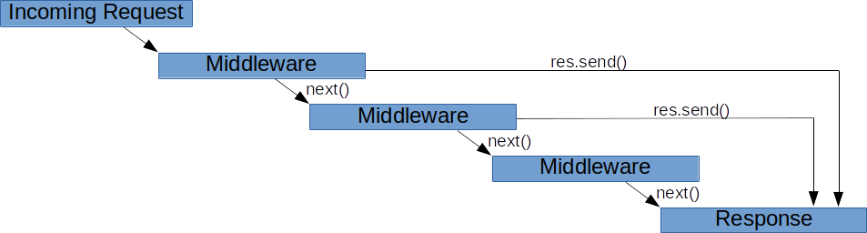
Express JS
Middleware is a piece of software that sits in between the request and the response.

Slide 21
CODE TIME

